Slide 1
The Employee’s Notepad

Slide 2





Slide 3
When we first started to brainstorm we thought of an app that would do everything we mention in these slide but after not really haven't knowledge on app making so, we all thought we should stick with what we know and make the skeleton of a webpage, we first thought we could come up with a clock in and out system so when you clock in you are also asked about your stress level what you want to be doing for the day and overall how there feeling and also do it for when they clock out and then you could use that information to not only check on the mental health on your staff but also a overall on how your business may be affecting your staff.
We then thought because of covid it would be best for the person to be able to clock in and out on there phone to reduce germs being past along.
Then we got on the lines of a web page as then it can be accessed anywhere with internet access.
We then started to brainstorm about what we could implement into our website and came up with a few ideas and mainly focused on mental health in and out of the workplace and tried to implement a mood board so that the employee could check in with everyone and the employee can help anyone who needs it or is to stressed within reason.
We thought if company's that people work for could get a sense of direction on how there company impacts the persons health or stress levels and then changes can be induced to help the company strive better.
As this is our first time doping a hackathon we wanted to take it slowly and not rush into things so we though we would come up with the skeleton of the webpage and most of the information for the webpage to hopefully get our idea across.

Slide 4
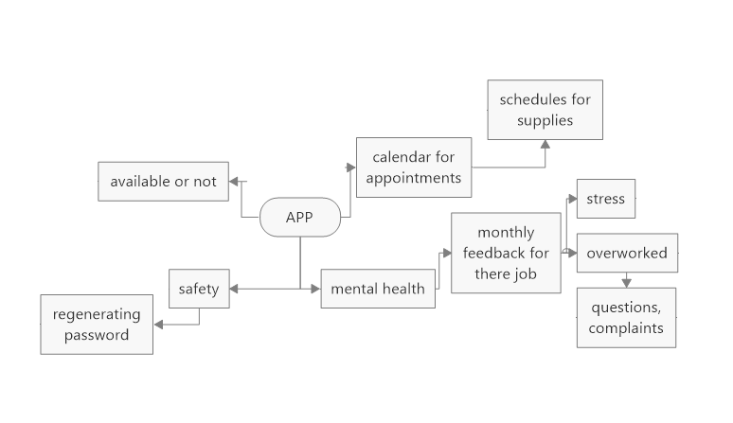

Slide 5
The employee notebook
We wanted to make a webpage which stores the employee’s notes and appointments so it is easily assessable and everything is in one place with multiply people being able to access there schedule and arrange appointments to the time the employee is available , we also wanted to implement how mental health has a massive impact on the population with mental health rising by a least 20% due to the pandemic and throughout the years, we wanted to implement a feedback option that the employee doesn’t have to fill out, but we feel this would not only help the employee with there mental health not only inside of work but hopefully outside too as we could also implement an anonymous section for people with less confidence.
With the feedback section the employer can understand how the employees are feeling and could also get feedback to better the company with ideas that could benefit the workplace to make it feel more safe and relaxing.

Slide 6
Starting Webpage
Log In
Work ID:
Password:

Slide 7
Log in page.
Our log in page will get the user to input there work ID and there password, the work id will be given to them by there workplace and there password will be chosen by them. For security reasons there will be a change password button on the main page that will have a 30 day count down so it reminds them to change there password. (this can be done anytime and as soon as the password changes the counter will start from 30 again)if they fail to change there password within 30 days it will ask them as soon as they log on, this will only happen on the 30th day and after they have changed the password they will be forwarded to the homepage.
We would need to implement a database so that we have the right work IDs for people and the saved passwords which would need to be encrypted,

Slide 8


Slide 9
Homepage
This page will implement all the web pages to do with the website including,
Calendar
Feedback
Change password (day counter on how long they have left to change password)
Phonebook / email address book
Notes

Slide 10

JANUARY 2021
Calendar
SUN | MON | TUE | WED | THU | FRI | SAT
 |  |  |  |  | 1 | 2
3 | 4 | 5 | 6 | 7 | 8 | 9
10 | 11 | 12 | 13 | 14 | 15 | 16
17 | 18 | 19 | 20 | 21 | 22 | 23
24 | 25 | 26 | 27 | 28 | 29 | 30
31

Slide 11
Calendar
The calendar will be a place where other colleges and bosses can visit and see there times table and set up meeting with everything having to be confirmed by the employee, this will include meeting places if it is a face to face meeting and also states what streaming service they will use if it is an online meeting.

Slide 12
Feedback
This is a place that the employee could use for any feedback to the company, you can leave a name or it can be anonymous
This is a mood board asking how the employee is feeling and to check in on there mental health, work, life.

Slide 13
Feedback
This is a place that the employee can really unwind with any questions or concerns and complants, they can either do this anonymously or they can put there name down.
This is also a place where the mood board is, so the employer can get a real sense on how his company is impacting his staffs health and not only that it would give the employee chance to help out a employee who might be having a bad week, day or month because of personal issues.

Slide 14
Change Password
Change Password
(30) days remaining
Old password:
New Password:

Slide 15
Change password
This is a simple button that counts down the days before you need to set a new password, this can be set by the employee on how many days they want in-between the employees changing there password.

Slide 16
Our research
We researched a bit into mental health working in and out the workplace, and tried to implement this in our design, as this webpage can be accessed anywhere with internet access, and can access all the documents they would need for working, we also implemented a calendar this is because we can schedule a pick up or delivery date of paperwork if needed by the company. Due to covid this is an implementation to be safe.

Slide 17
Advantages of working at a workplace
1. Time Management
2. Behaviour and Interpersonal Skills
3. Become creative
4. Networking
5. Easier communications with seniors and employees.
How it impacts mental health: The working environment has its advantages,
time management is one of the most important advantages you can have. It
let’s us separate your work life and personal life; it also allows you to behave yourself in front of others and make use of your interpersonal skill.
Which will result in having easier communications with co-workers, having the chance to build your network with others. And you become creative in how you approach and do your work. Making the working environment a healthy place.

Slide 18
Disadvantages of working at the workplace
1. Accidents
2. Lack of privacy
3. Increased stress
4. Personality Clashes
5. Leadership Issues
How it impacts mental health: The working environment also has its disadvantages,
you are prone to accidents and having injuries. Lack of privacy is also one,
not all people are extroverts and having to work in open spaces may make.
introverted people feel uncomfortable. Not only that, but personality
clashes may also happen; it happens when one is not in agreement with another.
Which will result in increased stress, more pressure from the workload. And
disorganized team leaders can add to the stress. Making the working environment
stressful to work at.

Slide 19
Advantages of working at home
Less Commute Stress
Location Independence
Money Savings
Positive Environmental Impact
Improved Inclusivity
How it impacts mental health: Working remotely has its advantages, one of them is having less commute stress, and from that you costless in transportation. With less transportation, we allow ourselves to have a positive environmental impact. It also allows companies to embrace diversity and inclusion, hiring people with different geographic and cultural backgrounds. Making going to work less hassle.

Slide 20
Disadvantage
Unreliable Internet Connection
2. Interruptions/Distractions at Home
3. Heavier Workload
4. Coordination Issues with Co-workers
5. Longer Working Hours
How it impacts mental health: Working remotely also has its disadvantages, it also means you are prone to interruptions more than ever. Having an unreliable internet connection is not an exemption. Not all of us have the leisure to have an internet provider, not only that but also you have to deal with internet speed. And with slow internet speed, coordinating with co-workers will be even harder. Coordinating harder also means, having heavier workload than normal. Making WFH stressful.

